Slide 1

Pre-header
Title

Slide 2
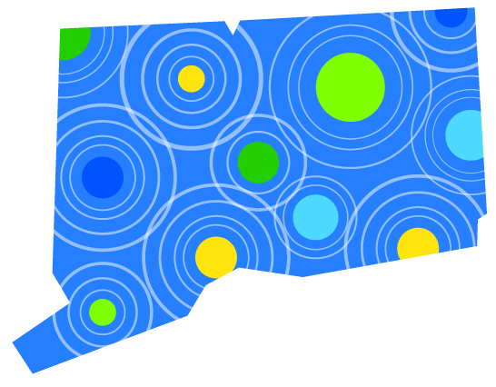

Sustainable CT
Vision and Overview
Roadmap of Actions
Resources: Technical Assistance
and Funding
Certification
Impact and Benefits
Get involved

Slide 3
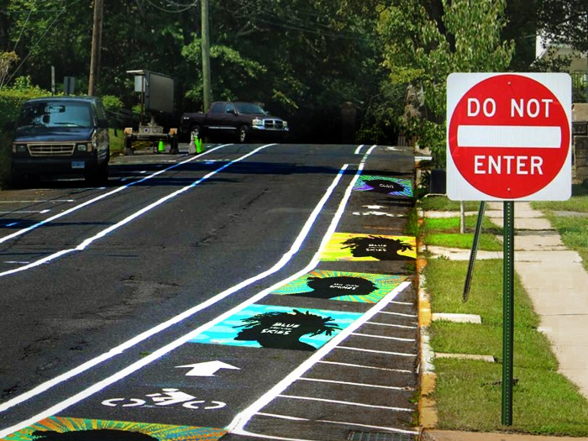
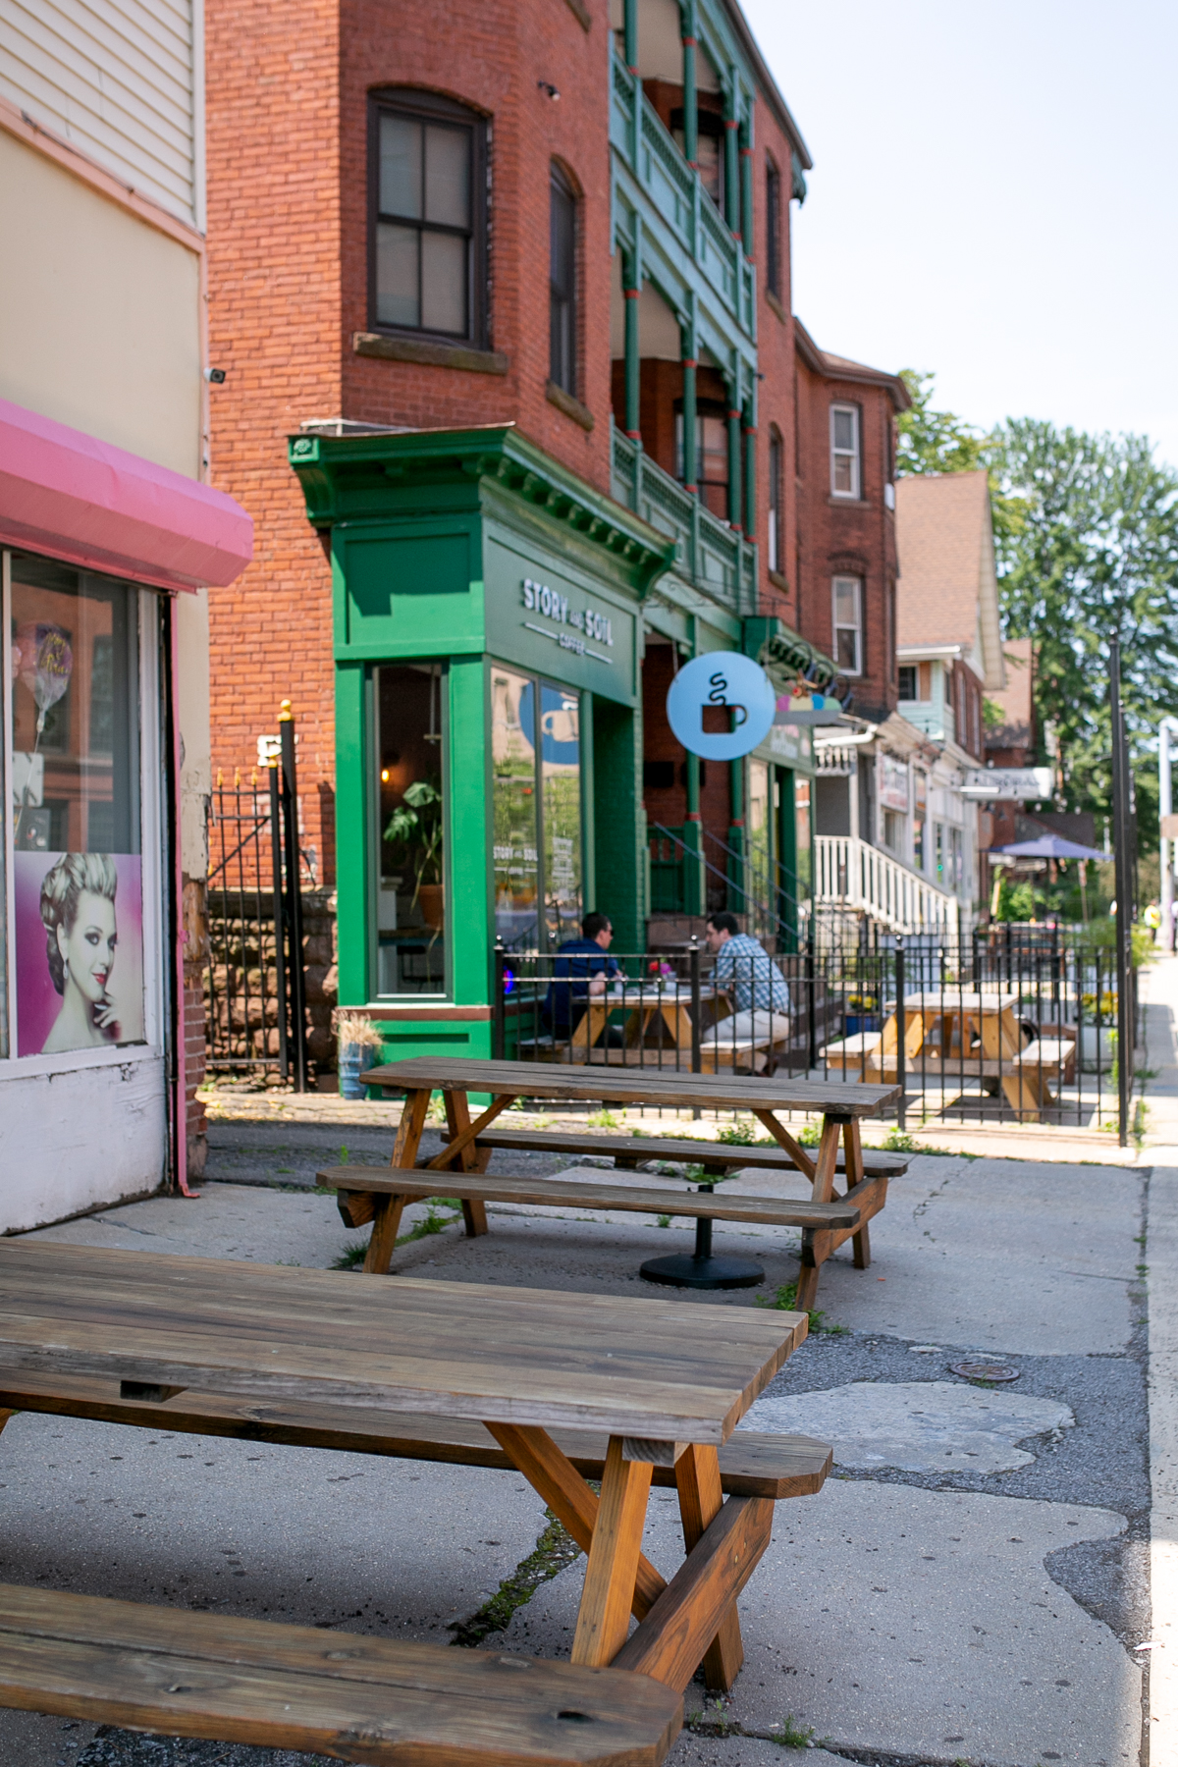
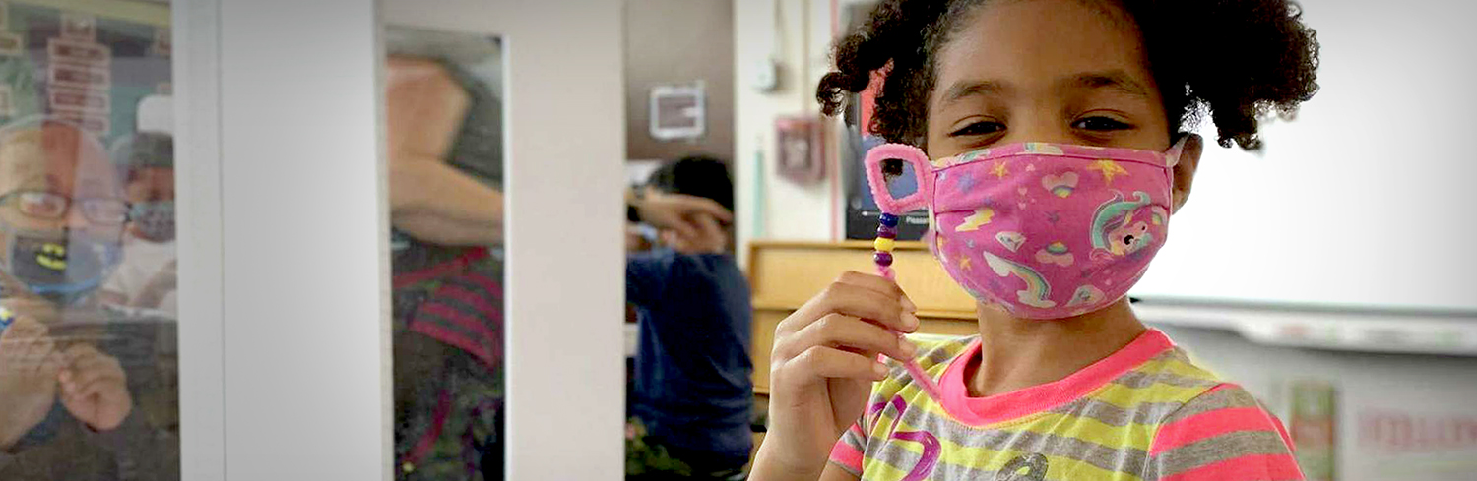
Sustainable CT: Our Vision
Sustainable CT strives to be inclusive, innovative, and collaborative.
We are committed to equity, and to creating communities where all are welcome and have the opportunity to thrive.
We recognize the natural environment as the foundation for the health and well-being of all people and the strength of the local economy.

Slide 4


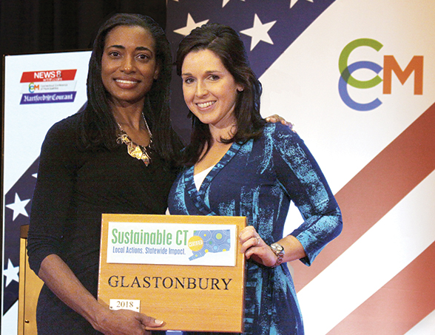
Advancing Sustainability Through…
Roadmap
Menu of sustainability actions
Resources
Technical assistance and funding
Certification
Recognition and celebration of achievements

Slide 5
Roadmap of Actions

Slide 6
Roadmap of Voluntary Actions
Inclusive and equitable community impacts
Thriving local economies
Well-steward land and natural resources
Vibrant and creative cultural ecosystems
Dynamic and resilient planning
Clean and diverse transportation systems
Renewable and efficient energy infrastructure and operations
Inclusive engagement, communication and education
Strategic materials management
Optimal health and wellness opportunities
Healthy, efficient, and diverse housing
Effective, compassionate homelessness prevention

Slide 7
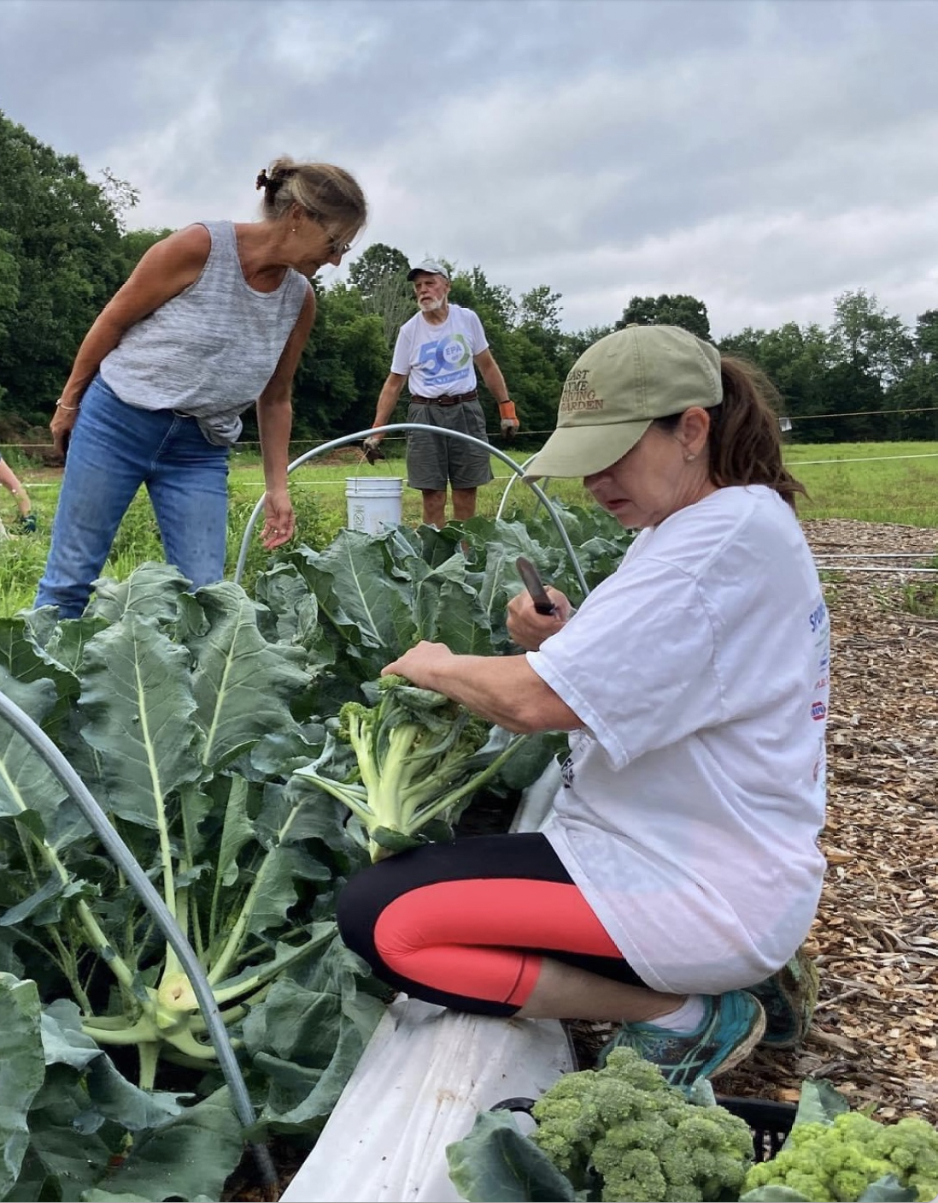
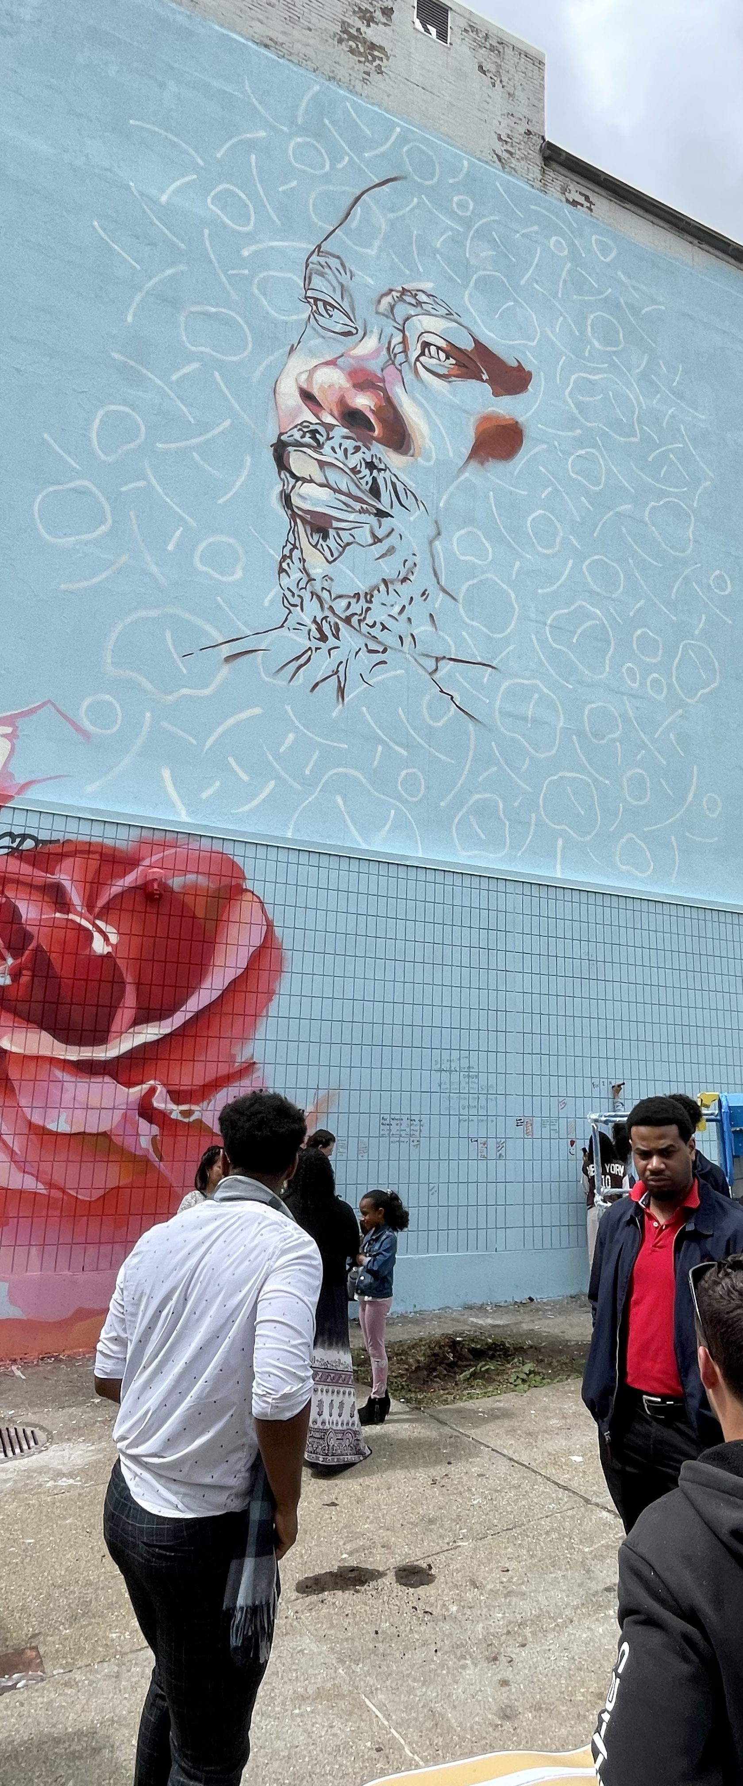

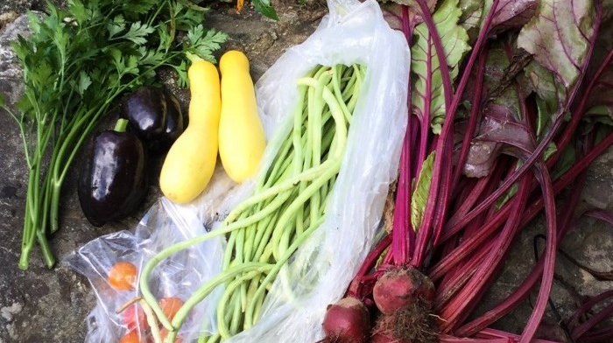
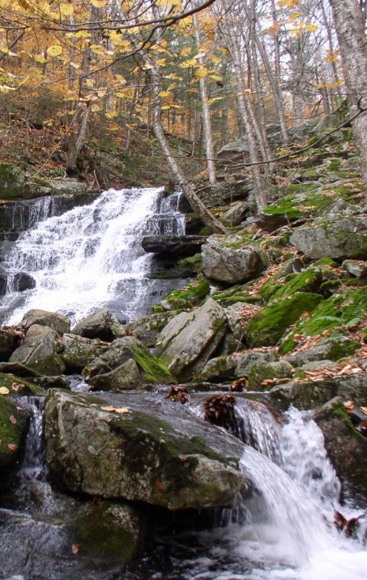

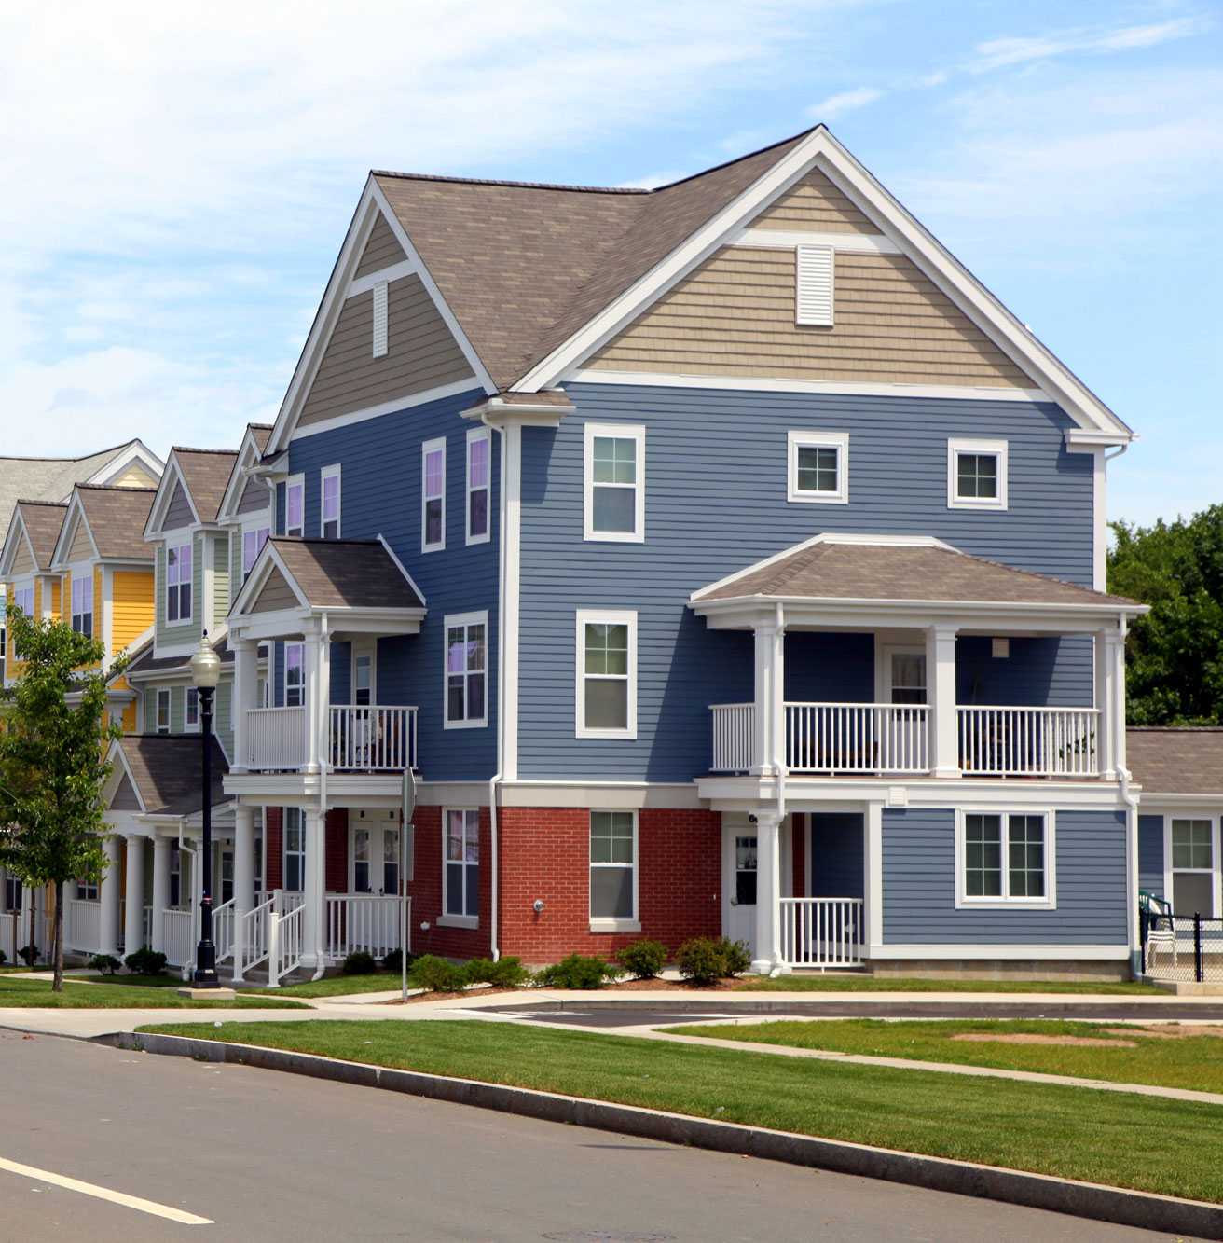
What Does Action Look Like?
Examples of the 200+ Qualifying Possibilities
Purchasing of sustainable goods and services
Watershed protection programs
Arts and culture initiatives
Inventory and assessment of historic resources
Pro-sustainability permitting process
Agriculture friendly practices
Energy use reduction across municipal buildings
Healthy and sustainable food networks
Housing needs assessment

Slide 8
Resources

Slide 9
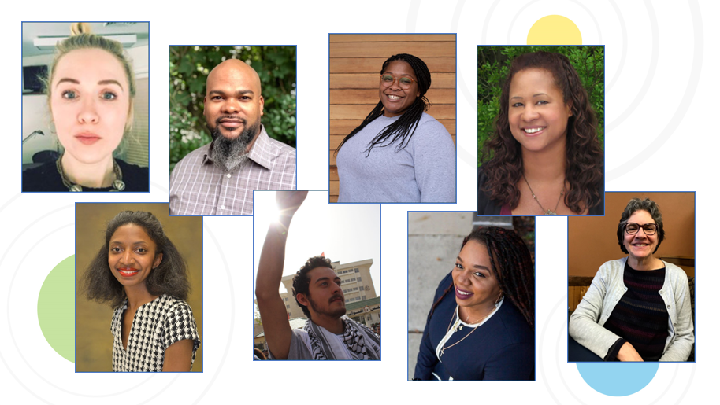
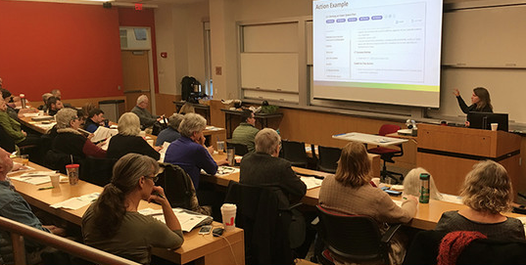
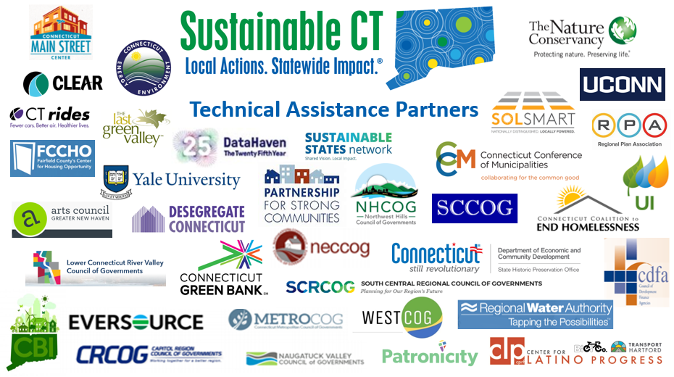
Support and Technical Assistance
Equity Coaches
Workshops, Training
Technical
Assistance Partners
Fellowship Program
Notes:
NEED TO UPDATE equity coach montage (Christina no longer a coach) and update fellows to 2022 cohort

Slide 10
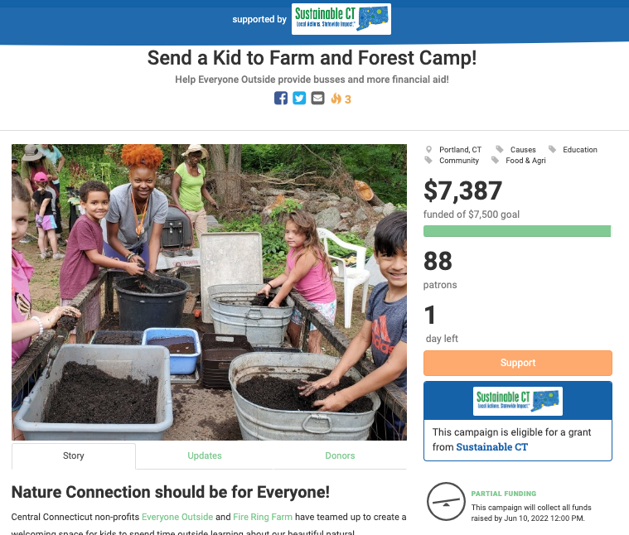
Community Match Fund
  Fast, easy, flexible, no deadlines
  Anyone with a good idea to improve their community
  Crowdfunding doubled by $1-to-$1 matching grant from Sustainable CT
  Up to $7,500 from matching grant
  Coaching and support for project leaders
  More than $2.5 million invested in over 220 community-led projects statewide

Slide 11
Certification

Slide 12



Certification
2022 Bronze
Certification Requirements
Complete 1 Equity Toolkit
in Action Optimize for Equity.
Complete at least 1 action
in each of the categories (1-12).
Successfully complete actions
totaling 200 or more points.
2022 Silver
Certification Requirements
Complete 3 Equity Toolkits
in Action Optimize for Equity.
Complete at least 1 action
in each of the categories (1-12).
Successfully complete actions
totaling 400 or more points.
2023 Gold
Certification Requirements
COMING IN 2023!

Slide 13
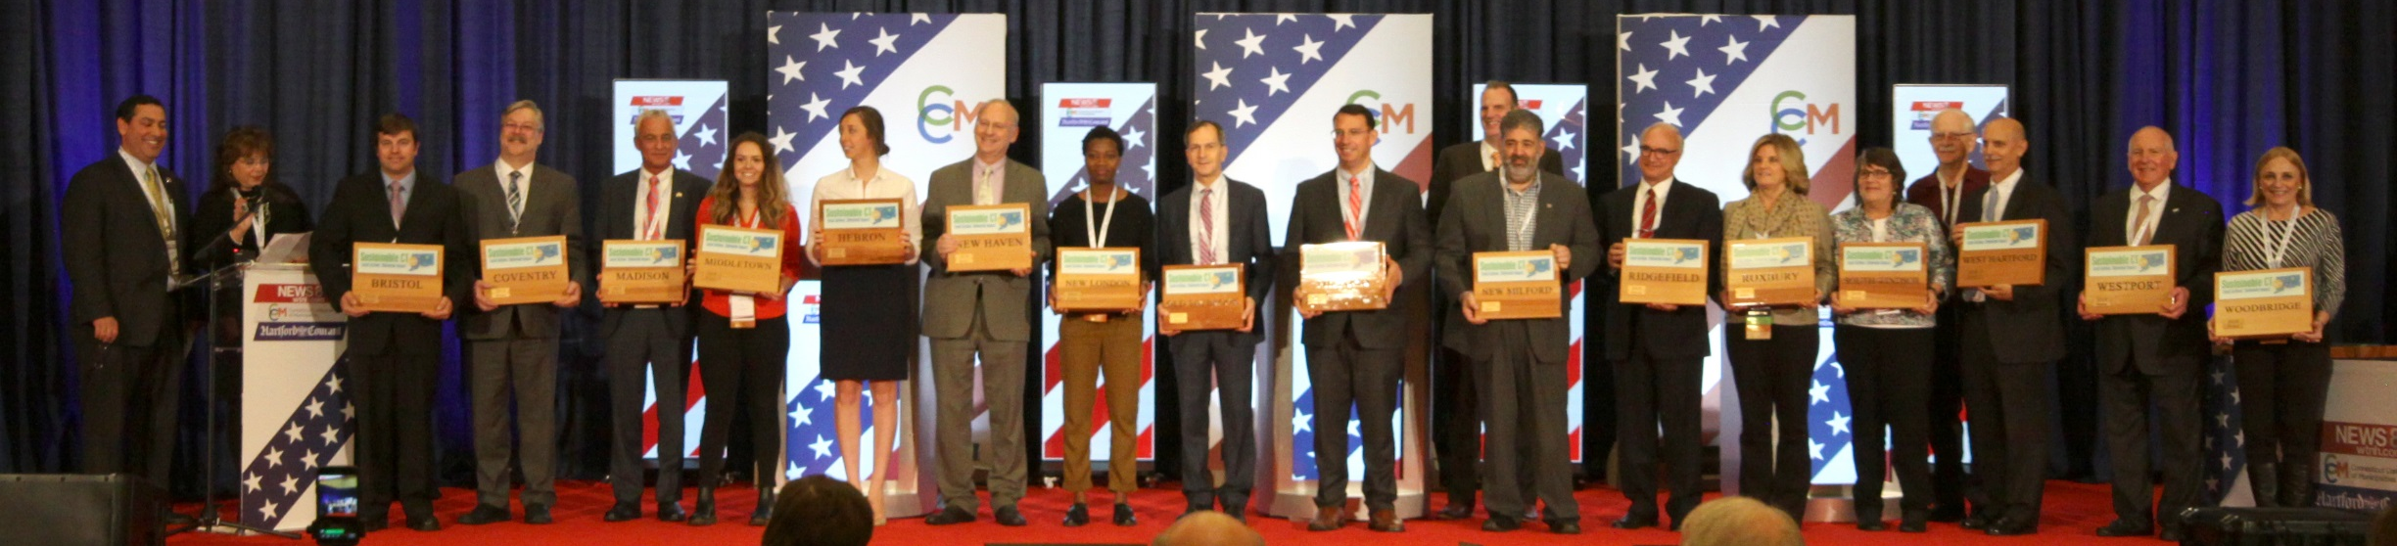
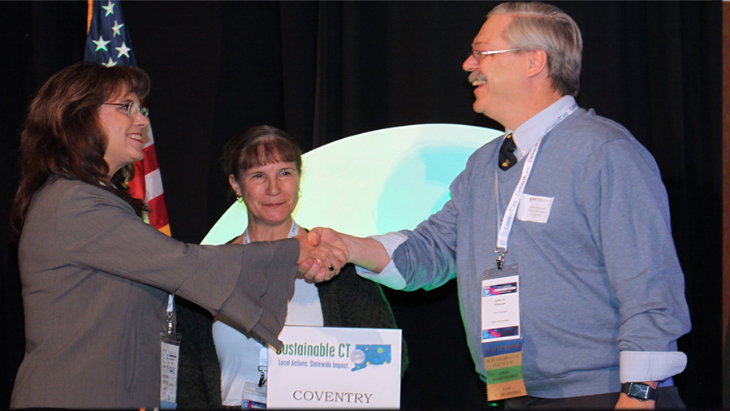
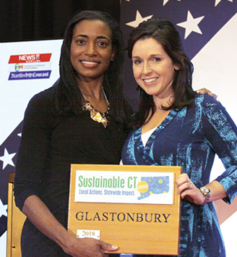
Recognition

Slide 14

Climate Leaders Designation
Goals:
Create high visibility around climate action within the Sustainable CT framework
Accelerate municipal implementation of high-impact GHG actions
Advance and align with state climate goals through collective municipal action
2022 Pilot Year:
Climate Leaders Designation is an add-on to certification, showcasing towns that include high-impact GHG actions in achieving Sustainable CT certification
Municipality can choose any combination of Climate Leaders actions to earn 140 points

Slide 15
Impact and Benefits

Slide 16
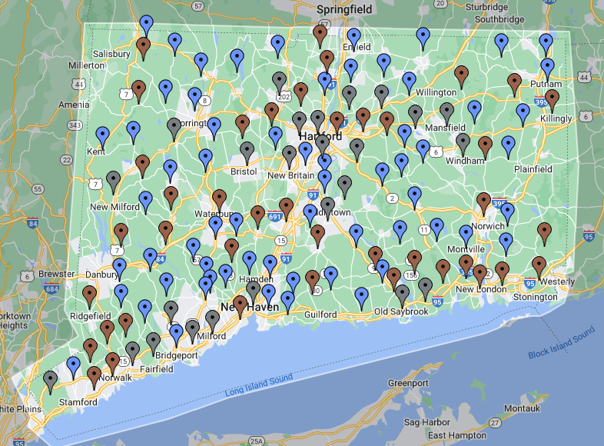
Impact
129 CT towns participating (76%)
66 towns certified, representing 60% of population
More than 2,750 sustainability actions implemented
More than $2.5 million invested in community-led projects
Connected, inclusive, resilient communities

Slide 17
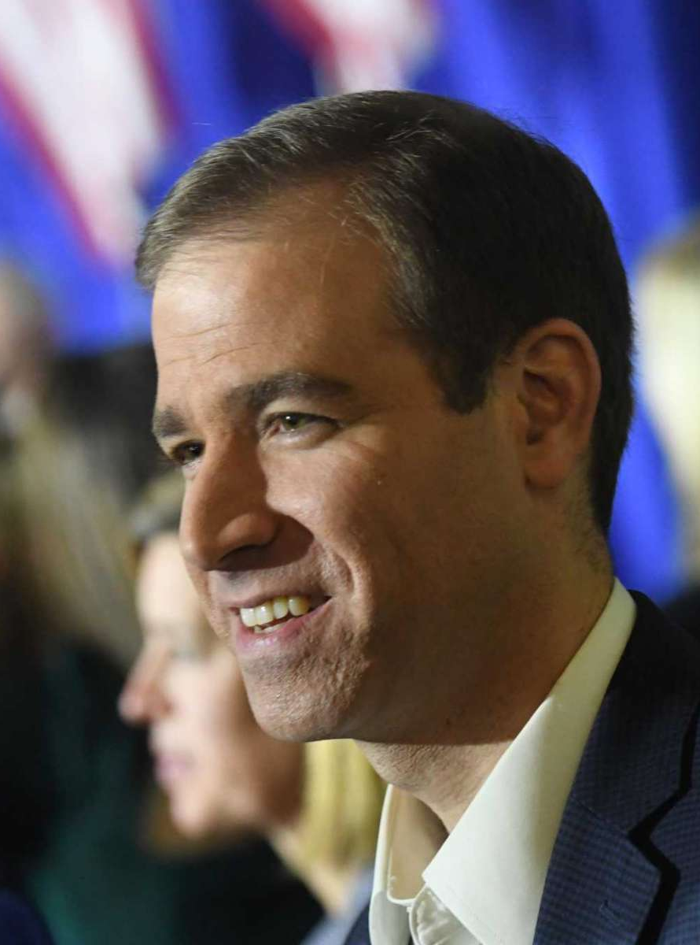
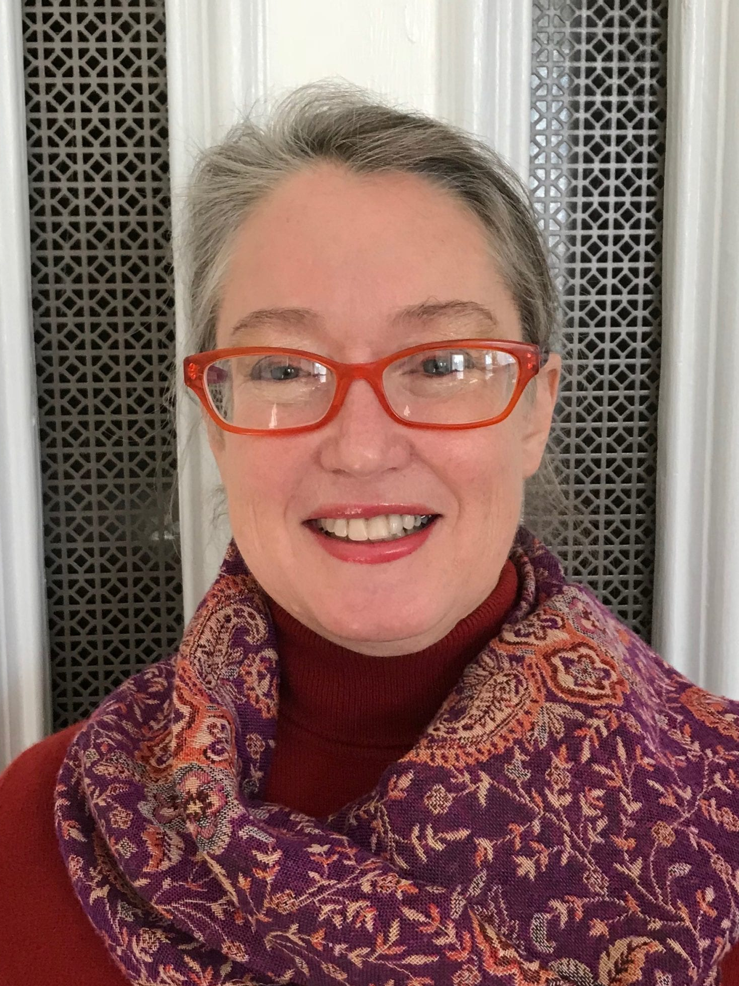
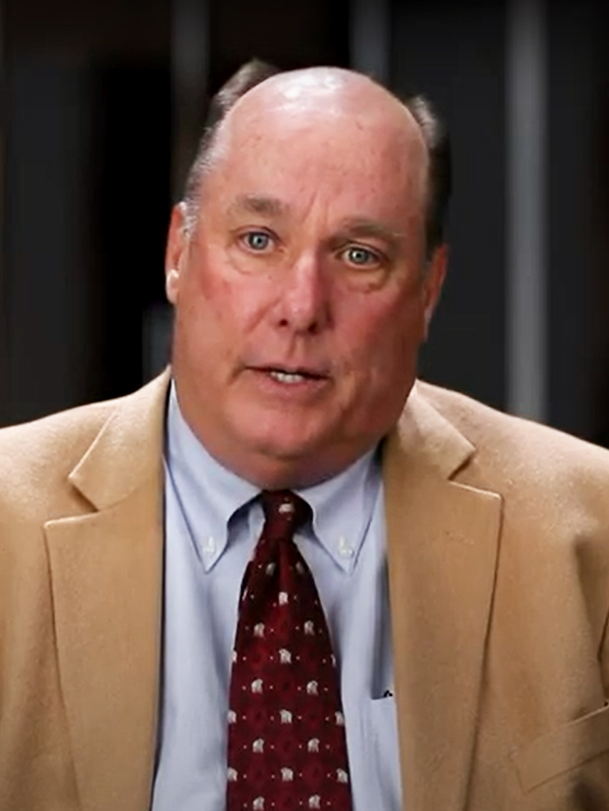
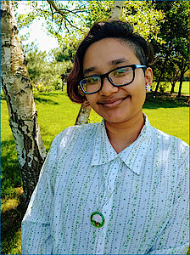
“We are proud to see Hartford recognized once again with a Sustainable CT silver-level certification… and I want to thank Sustainable CT for their leadership in building a more sustainable Connecticut.”
—Mayor Luke Bronin, Hartford
Benefits
“Thanks to Sustainable CT’s jump-start, I Heart My Home CT is assisting other agencies and municipalities to meet their residential energy efficiency targets.”
—Kathy Fay, Director of Community Sustainability, NHS New Haven
Protects the environment and reduces greenhouse gases
Saves money
Provides a rallying point and collective vision
Offers access to matching funds for projects
Recognizes/showcases your accomplishments and commitment to sustainability
Promotes civic pride
Attracts new business, smart development, a skilled workforce and new families
“The [Equity] Coach helped us sharpen our focus on reaching out to the East Hartford community, to gain input and suggestions of individuals who may be underserved.”
—Tom Baptist, Director of Public Works,
East Hartford
“This fellowship gave me a unique professional experience at the intersection of nonprofit work and municipal government.”
—Adrian Huq, 2022 Sustainable CT Fellow
with Naugatuck Valley Council of Governments

Slide 18
Get Involved

Slide 19
Become a Sustainable CT Community
1
2
3
4
5
6
Pass a resolution, establish a Sustainability Team.
Register your community at sustainablect.org.
Set a vision for how to improve your community using Sustainable CT’s roadmap.
Optimize for Equity – Start working on your equity action submission.
Complete at least 1 action in each category. Use our tools and resources!
Get certified!
Notes:
ALY

Slide 20

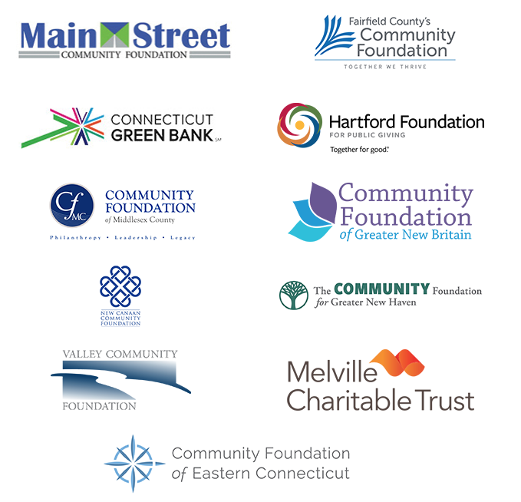

Thank You, Sustainable CT Funders

Slide 21
[ADD PRESENTER CONTACT INFO]
www.sustainablect.org
info@sustainablect.org

